Slide 1

Fall 2017
DATS 6450 Final Presentation
Bayesian Inference for a Time Series
Yi Le
Notes:
brief intro

Slide 2
Agenda
Introduction
Methods
Results
Conclusion
References

Slide 3
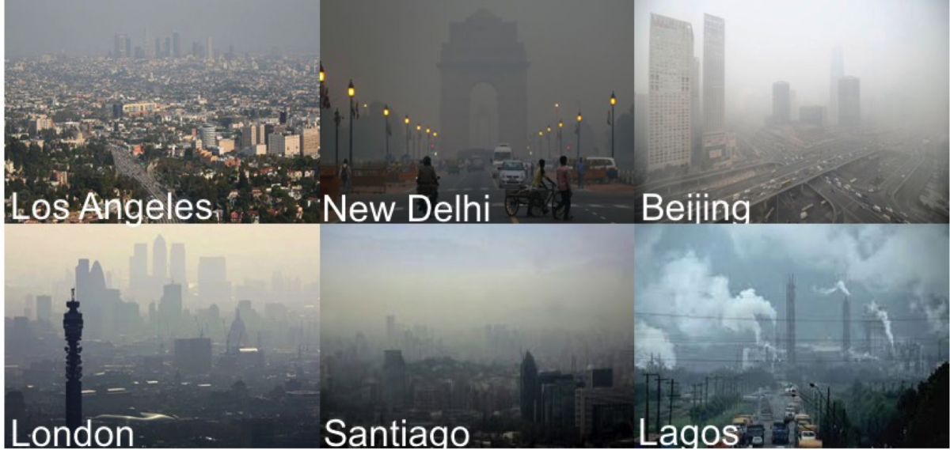
Introduction

Slide 4
Introduction
Datasets: PM2.5 index announced by US Embassy in five major cities in China from 2011 to 2015, with other parameters including temperature, humidity and so on.
Why time series?

Slide 5
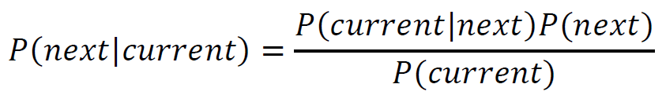
Methods
Naïve Bayesian Inference

Slide 6

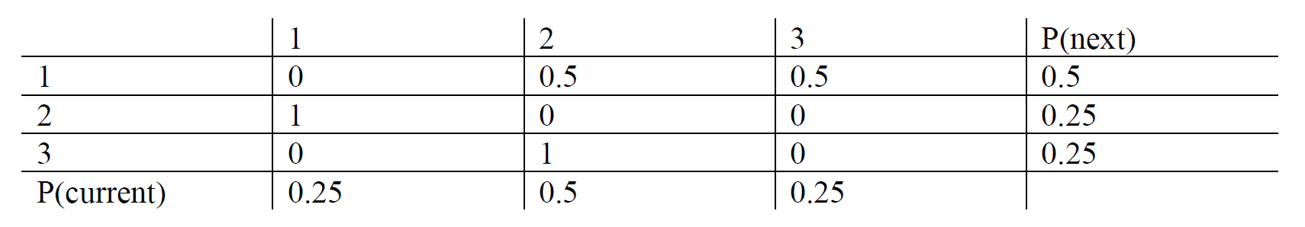
Methods
Naïve Bayesian Inference
P（current | next）

Slide 7
Methods
Bayesian Structural Time Series (BSTS)
A Bayesian method to figure out the relationship
between different time series. (e.g. regression)

Slide 8
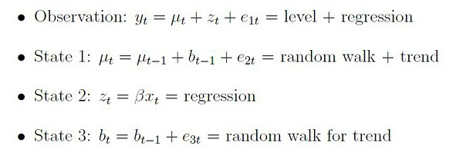
Methods
Bayesian Structural Time Series (BSTS)

Slide 9
Methods
Bayesian Structural Time Series (BSTS)
Spike-and-Slab Regression
A Bayesian variable selection

Slide 10
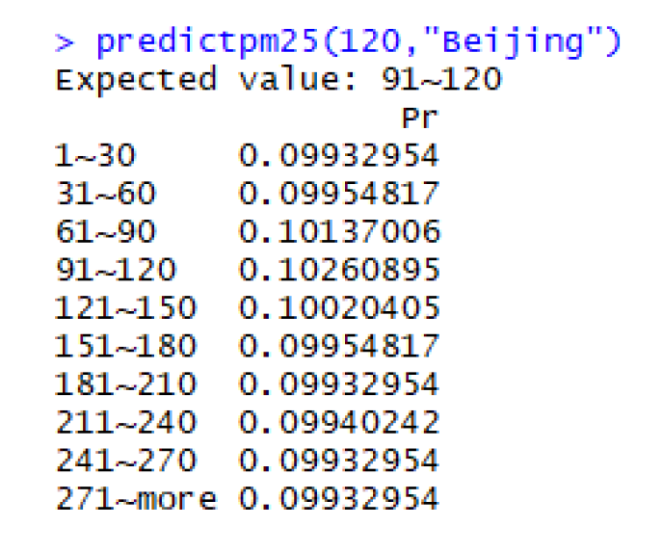
Results
Naïve Bayesian Inference

Slide 11
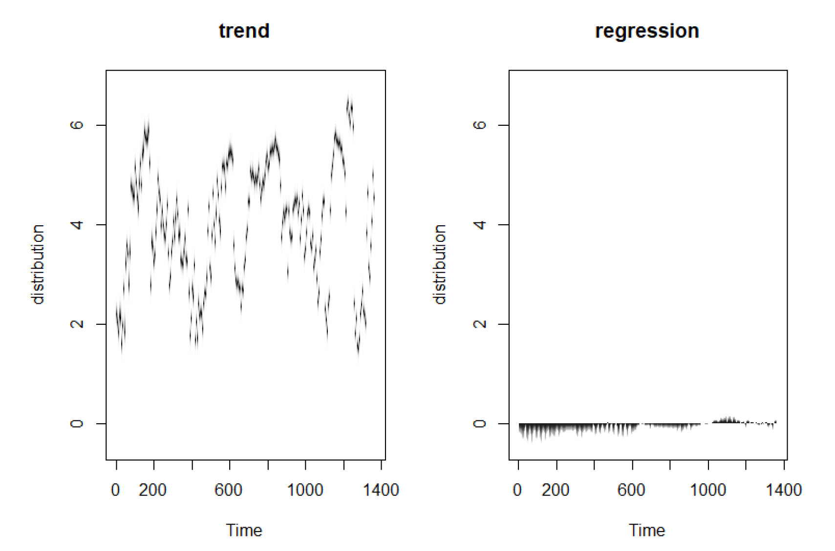
Results
Bayesian Structural Time Series (BSTS)

Slide 12
References
Scott, S. L., & Varian, H. R. (2014). Predicting the present with bayesian structural time series. International Journal of Mathematical Modelling and Numerical Optimisation, 5(1-2), 4-23.
https://site.douban.com/146782/widget/notes/15517178/note/321146275/
https://en.wikipedia.org/wiki/Bayesian_structural_time_series
https://en.wikipedia.org/wiki/Spike-and-slab_variable_selection

Slide 13


